Slide 1


To Nguyen Ngoc Nguyen 29th January 2023

Slide 2
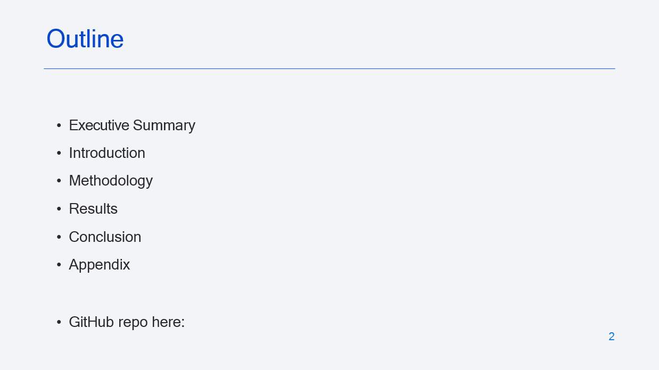
https://github.com/ToNguyenNgocNguyen/IBM_DataScience_Capstone

Slide 3
Executive Summary
The aim was to investigate the factors that affected the success of SpaceX missions. For example, the rocket design, payload, launch site and landing method.
SpaceX mission data was obtained from the SpaceX public API and
from SpaceX launch data on Wikipedia. The desired data was extracted and transformed for Exploratory Data Analysis (EDA) and visualization (including mapping and interactive dashboards).
Various machine learning classification models (logistic regression, support vector machines, decision trees, and k-nearest-neighbors) were trained and tested (and the hyperparameters tuned) to find the most accurate predictor of launch success.
The decision tree model was the most accurate predictor of launch success.
https://github.com/ToNguyenNgocNguyen/IBM_DataScience_Capstone
3

Slide 4
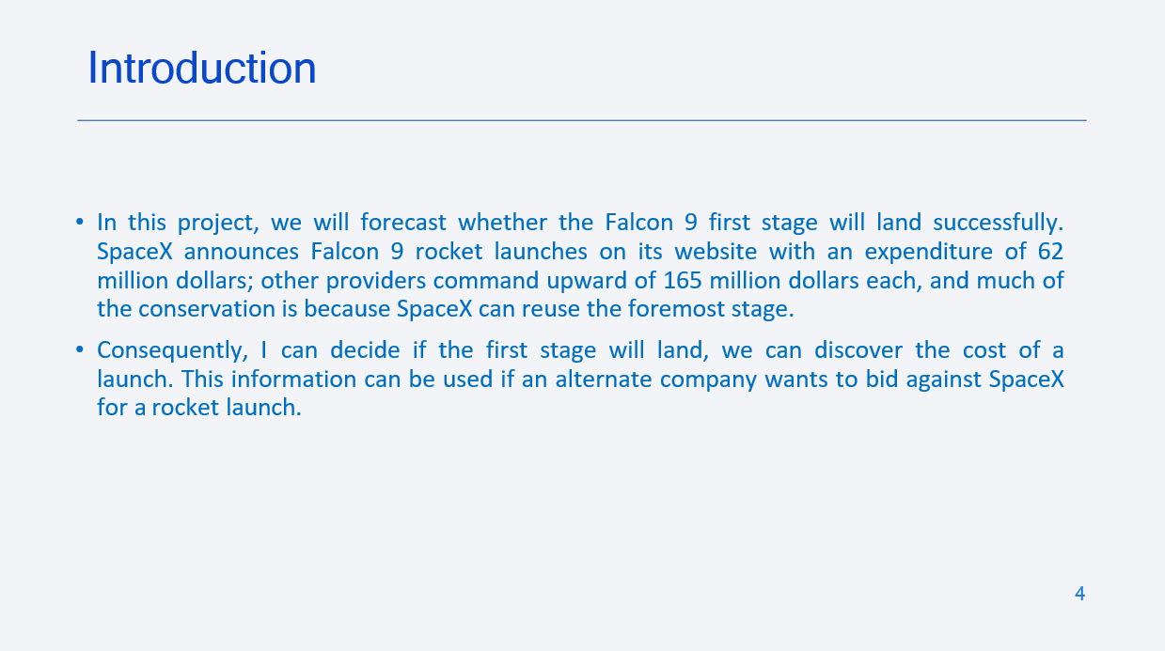

Slide 5

5

Slide 6
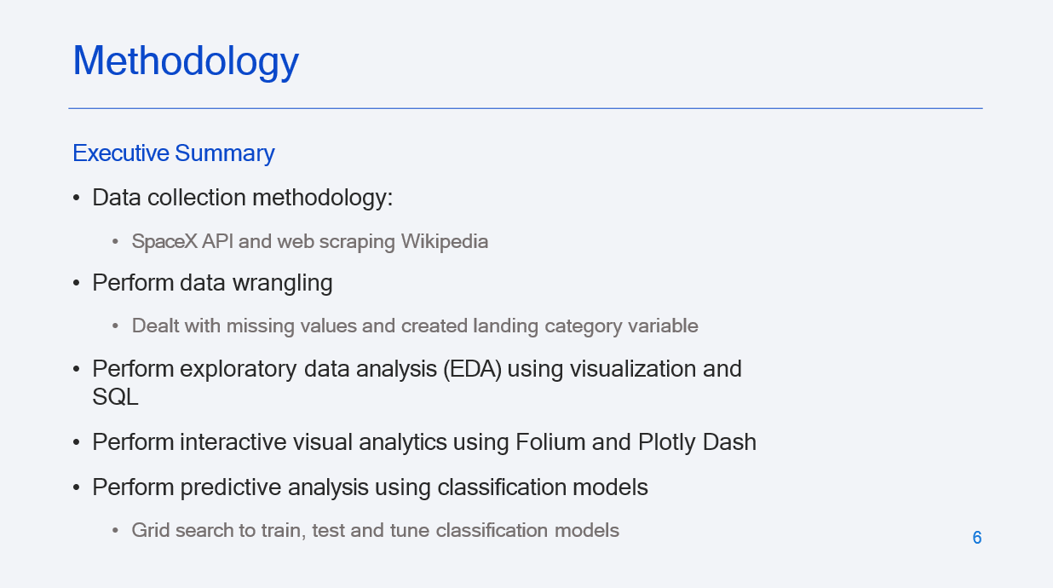

Slide 7
Data Collection – SpaceX API
SpaceX REST API requests are as follows:
Past launch data is requested from:
https://api.spacexdata.com/v4/launches/past
requests.get(spacex_url')
Booster data is gained from a rocket type request:
https://api.spacexdata.com/v4/rockets/
Launchpad name, longitude and latitude comes from a launch site request:
https://api.spacexdata.com/v4/launchpads/
Payload data comes from a payloads request:
https://api.spacexdata.com/v4/payloads/
Specific rocket core information comes from a core request:
https://api.spacexdata.com/v4/cores/
pd.json_normalize(response.json())
getBoosterVersion(data)
getLaunchSite(data)
Falcon 9 data was added to a pandas dataframe, then, after missing values dealt with, it was exported to a CSV file
https://github.com/ToNguyenNgocNguyen/IBM_DataScience_Capstone/blob/main/spacex_1_collection_api.ipynb
getPayloadData(data)
getCoreData(data)
7

Slide 8

Data Collection - Scraping
Used the requests library to scrape data
from https://en.wikipedia.org/wiki/List_of
_Falcon\_9\_and_Falcon_Heavy_launches
Used BeautifulSoup to parse the content returned in the response
The parsed data was added to a pandas dataframe and then exported to a CSV file
https://github.com/ToNguyenNgocNguyen/IBM_DataScience_Capstone/blob/main/spacex_2_webscraping.ipynb
Request url
Get content from response
Create Soup object from response
Find table headers
Find each row in turn
Extract the data from each row and
insert into a pandas dataframe
8
Save the dataframe to CSV

Slide 9


Data Wrangling
[Missing values dealt with previously]
A classification variable ("class") was created to encode the landing outcome as either 0 (bad) or 1 (good). The variable is the target variable that the classification algorithm will need to predict.
https://github.com/ToNguyenNgocNguyen/IBM_DataScience_Capstone/blob/main/spacex_3_wrangling.ipynb
Identify all landing outcomes
Identify bad landing outcomes
Iterate through all landing outcomes
If a bad outcome, encode as 0, else encode as 1
Add new encoding to
dataframe as "class"
9

Slide 10
EDA with Data Visualization
Here we perform Exploratory Data Analysis using Matplotlib visualization
techniques and Feature Engineering using Pandas.
Specifically, the relationships between Flight number, Launch site, Payload mass and orbit type were investigated using a variety of graphs types, such as scatter plots, bar graphs and line graphs.
All visualizations were color-coded by "class" so the effects of the variables and their relationships on the launch outcome were visible.
The features were engineered using one-hot-encoding (which turns categorical data into numeric data, suitable for the classification algorithms) and then all data was cast to a float64 type.
https://github.com/ToNguyenNgocNguyen/IBM_DataScience_Capstone/blob/main/spacex_5_eda_dataviz.ipynb
10

Slide 11
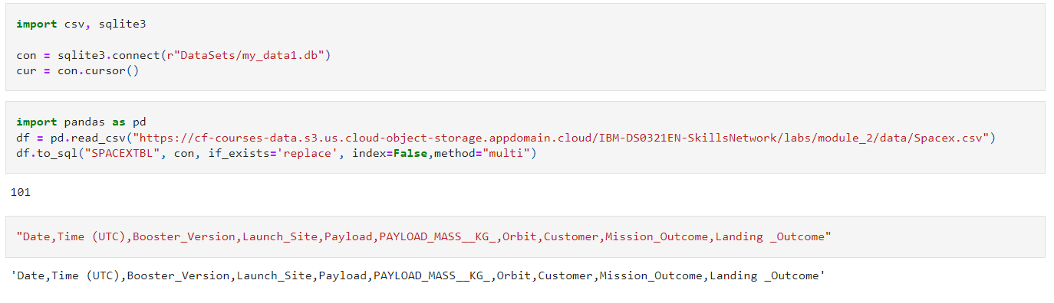
EDA with SQL
https://github.com/ToNguyenNgocNguyen/IBM_DataScience_Capstone/blob/main/spacex_4_eda_sql.ipynb

Slide 12
Build an Interactive Map with Folium
Circles and Markers were added to an interactive Folium map to indicate launch locations.
A MarkerCluster was added for each site to visualize the launch outcomes at each
site.
A line was drawn between a launch site and the coast and label with the distance was added to show the proximity of the two. Additional lines help users visualize distances to other important features that you want to avoid, such as roads, railways and towns/cities etc.
https://github.com/ToNguyenNgocNguyen/IBM_DataScience_Capstone/blob/main/spacex_6_launch_site.ipynb

Slide 13
Build a Dashboard with Plotly Dash
An interactive dashboard was created to allow users to investigate the effects of launch site, payload mass and booster type on the launch outcome (good or bad).
Launch site was selectable from a drop down menu and a range of payload masses could be selected using a slider control.
A pie chart showed either the successful outcome for all launch sites or the proportion of good and bad outcomes for any one selected launch site.
A scatter chart showed how the launch outcome varied by the selected site and
payload range and the data points were color-coded by booster type.
https://github.com/ToNguyenNgocNguyen/IBM_DataScience_Capstone/blob/main/spacex_7_dash_app.py

Slide 14


Predictive Analysis (Classification)
Scale data
Follow the process in the flowchart for the following classification algorithms:
Split data into training and test
data
Logistic regression
Support vector machines
Decision tree
K-nearest neighbors
Create classification model
object
Create a GridSearch object
https://github.com/ToNguyenNgocNguyen/IBM_DataScience_Capstone/blob/main/spacex_8_Machine_Learning_Prediction.ipynb
Use the GridSearch object to fit the model to the training data and tune the hyperparameters
Find an accuracy score by comparing model predictions to the test data
14
Compute a confusion matrix

Slide 15
Results
Exploratory data analysis results
Interactive analytics demo in screenshots
Predictive analysis results
15

Slide 16


Slide 17
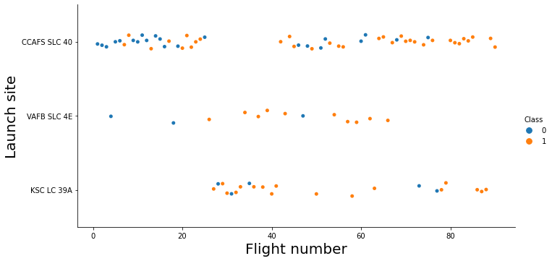
Flight Number vs. Launch Site
Scatter plot of Flight Number vs. Launch Site, colored by outcome (blue
= bad, orange = good)
CCAFS... has had the most tests but VAFB... and KSC have the higher success rate (probably because they were used for many of the later flights where reliability might have improved).

Slide 18
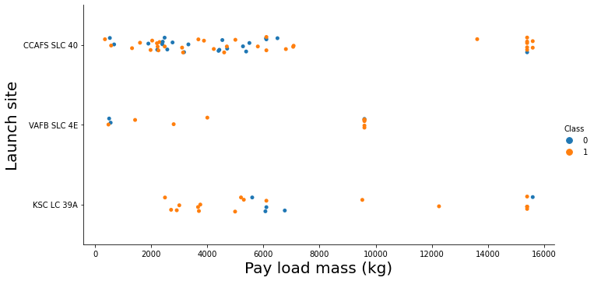
Payload vs. Launch Site
Scatter plot of Payload vs. Launch Site, colored by outcome (blue =
bad, orange = good)
VAFB... has not had many heavy flights.
Launches with
higher payloads were more
successful (possibly
because they were only carried out when the engineers knew that the reliability had improved and the extra cost of the payload would be safer).

Slide 19
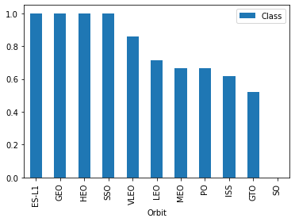
Success Rate vs. Orbit Type
Bar chart for the success rate of each orbit type
Higher orbits (GEO, HEO) seem to have higher rates of success.
Note that SSO = SO so actually that orbit isn't 100% successful

Slide 20
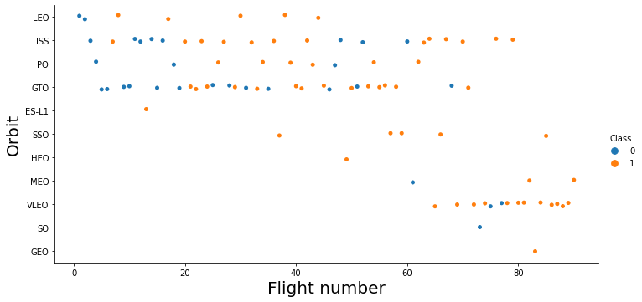
Flight Number vs. Orbit Type
Scatter point of Flight number vs. Orbit
type, colored by outcome (blue = bad, orange = good)
The outcomes have tended to improve across all orbits as the number of flights increased.

Slide 21
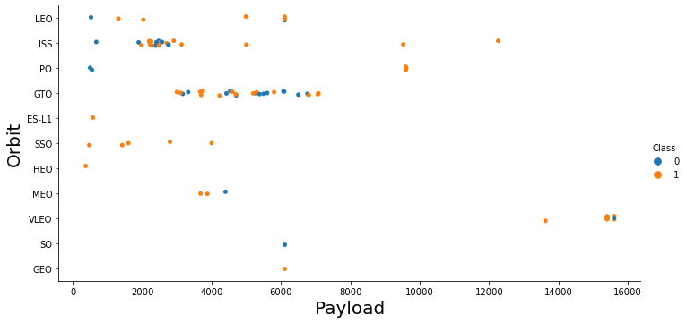
Payload vs. Orbit Type
Scatter point of payload vs. orbit type, colored by outcome (blue = bad, orange = good)
There are no clear patterns of increased success with increased payload for any given orbit.
SSO orbit is appears consistently successful (note that SSO = SO so actually it isn't 100% successful).

Slide 22
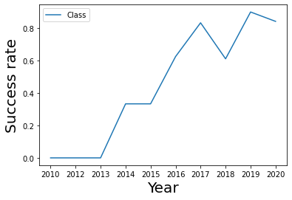
Launch Success Yearly Trend
Line chart of yearly average
success rate
The success rate has been steadily increasing since 2013, although there was a dip around 2018.

Slide 23
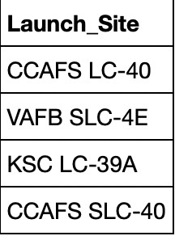
All Launch Site Names
The names of the launch sites
SELECT DISTINCT selects the unique values from the specified column.

Slide 24
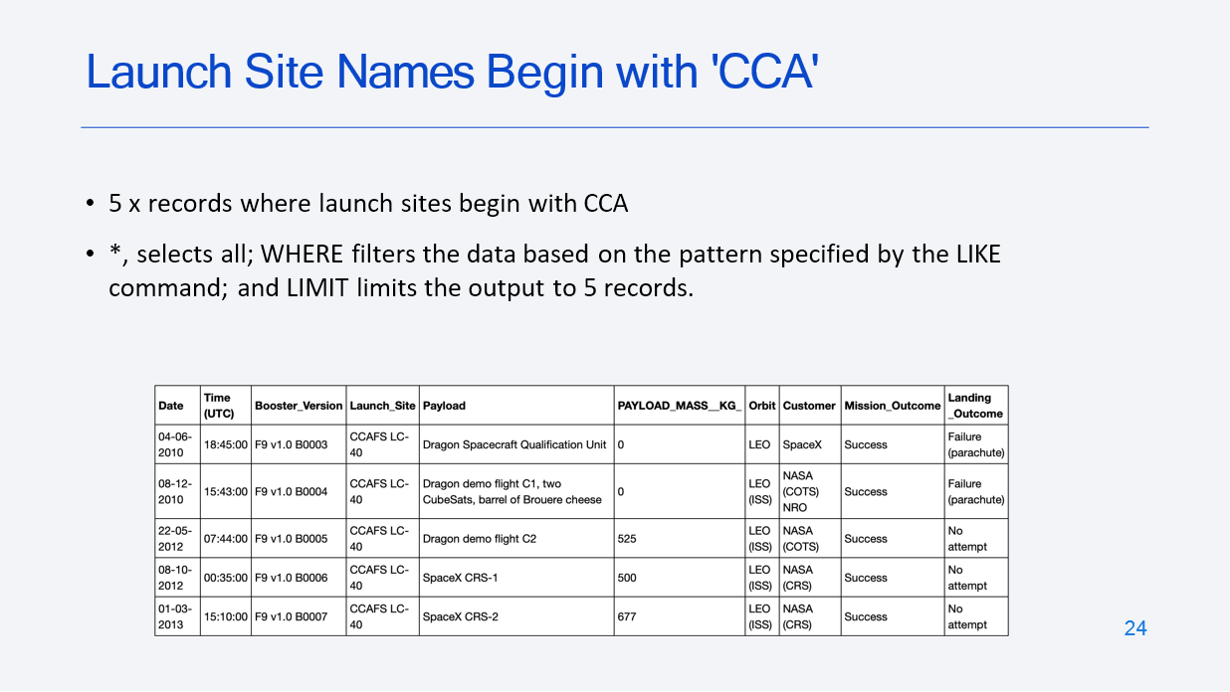

Slide 25
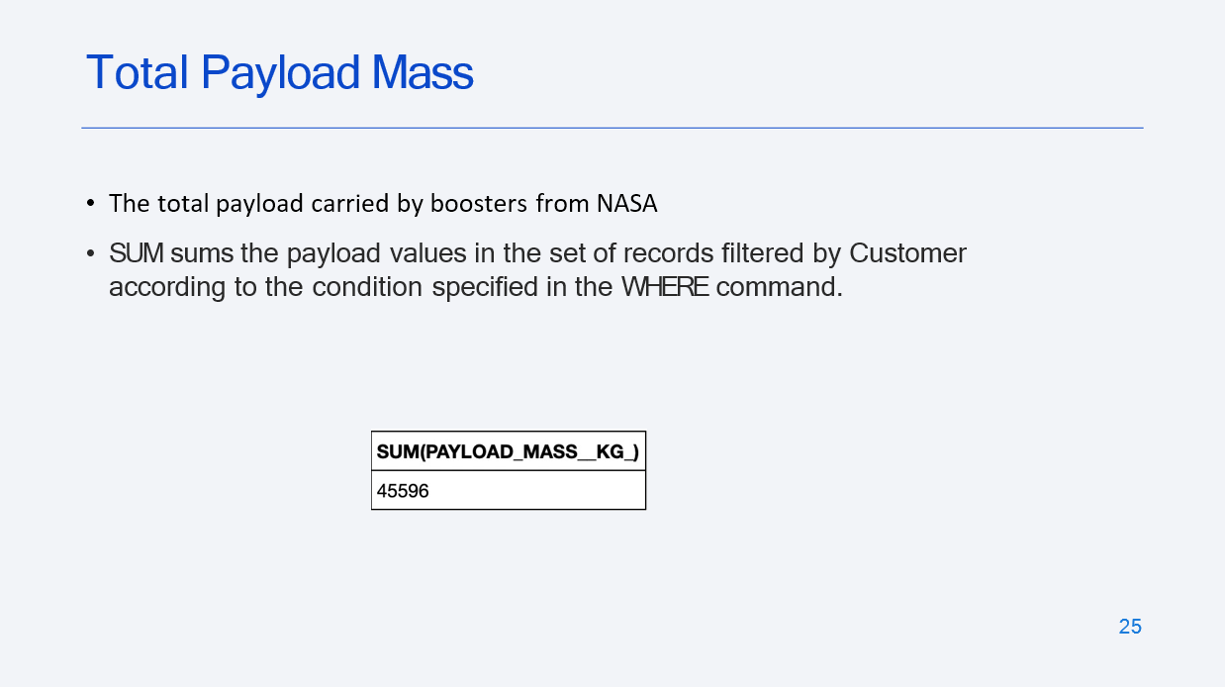

Slide 26
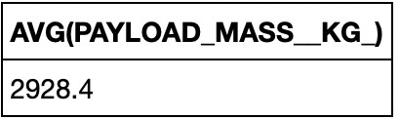
Average Payload Mass by F9 v1.1
Calculate the average payload mass carried by booster version F9 v1.1
Similar method to the last slide but using AVG and a different filter condition.

Slide 27
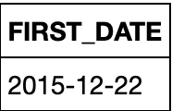
First Successful Ground Landing Date
Find the dates of the first successful landing outcome on ground pad
With SQLLite there is no date type so dates are strings and you have to use the above substr command and patterns to correctly order the date returned by each record so that you can used the MIN command to find the first one.

Slide 28
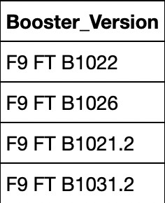
Successful Drone Ship Landing with Payload between 4000 and 6000
List the names of boosters which have successfully landed on drone ship and
had payload mass greater than 4000 but less than 6000
The BETWEEN command is useful for filtering records by some range of values within a column.

Slide 29
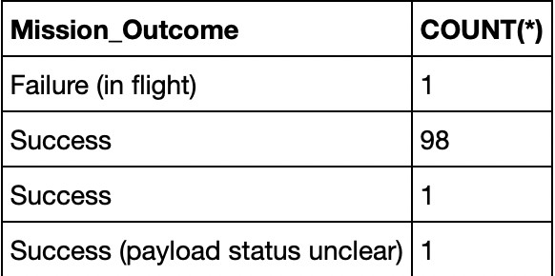
Total Number of Successful and Failure Mission Outcomes
COUNT(*) returns the count, GROUP BY aggregates the data according to the specified variable.

Slide 30
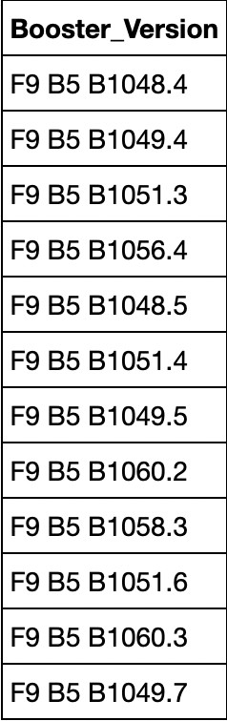
Boosters Carried Maximum Payload
A subquery is used to find the maximum payload mass across all records [using MAX()] and that returned value then becomes the filter with which to select all booster versions that have carried that mass.

Slide 31
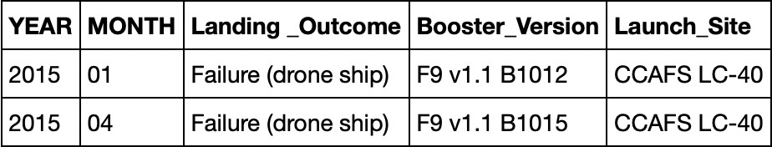
2015 Launch Records
More SQLLite date handling. The AND condition is used to create two
filters with each one working one value in a specific column.

Slide 32
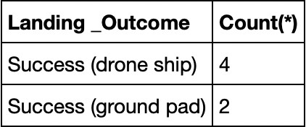
Rank Landing Outcomes Between 2010-06-04 and 2017-03-20
Rank the count of successful landing outcomes between the date 2010-06-
04 and 2017-03-20, in descending order
More SQLLite date handling, plus DISTINCT plus a filter range using BETWEEN and aggregation of outcomes using GROUP. [Note my assignment clearly asked for successful outcomes only.]

Slide 33


Slide 34
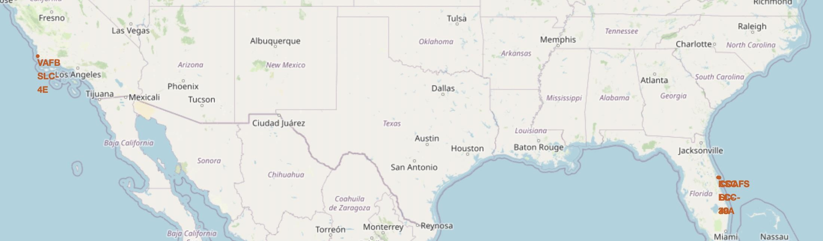
Launch site locations
The launch sites are next to the coast and major oceans.

Slide 35

Launch site outcomes
Clustered set of markers showing launch outcomes for launch site KCS.

Slide 36
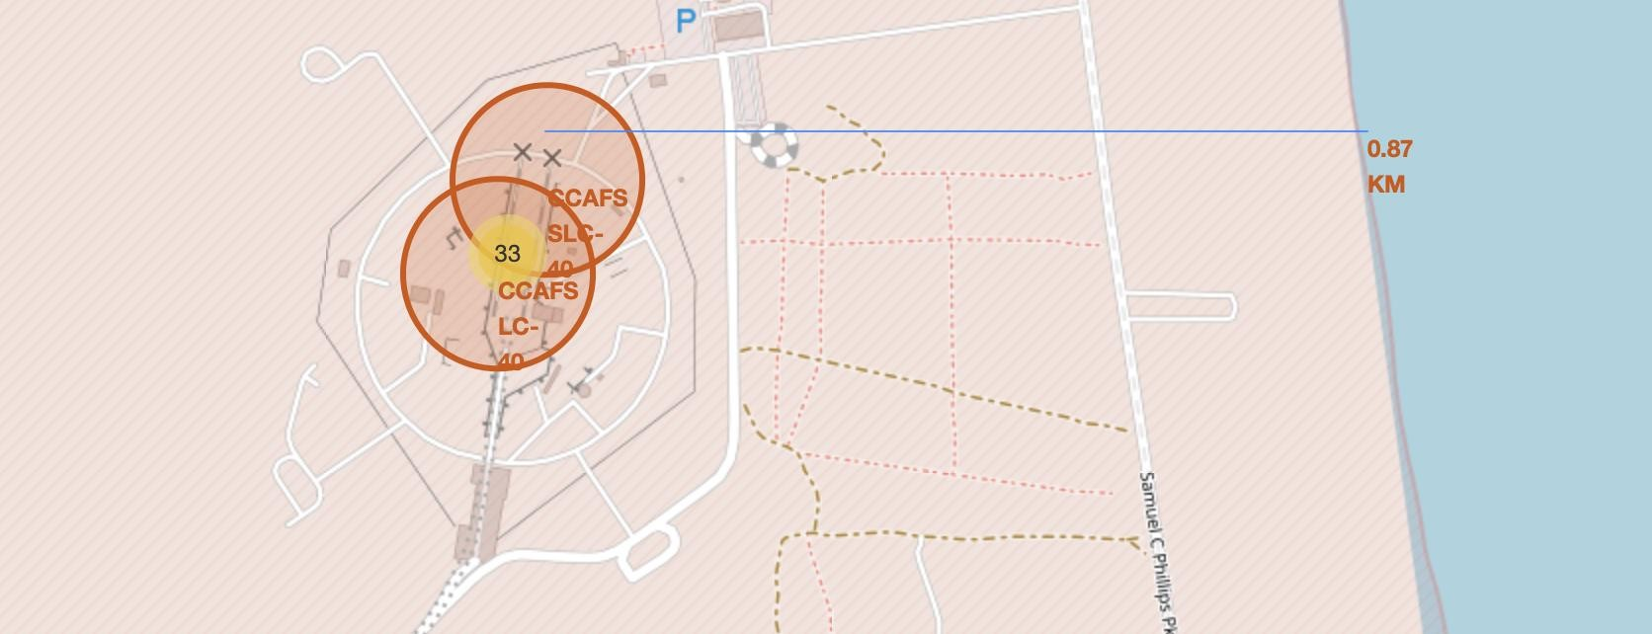
Proximity of launch site to other land/coastal features
It could be important to know how far a launch site is from other land/coastal features. [Honestly, this was an exceptionally dull task. I hated it. So there was no way I was going to waste my time drawing other lines to other features. It has nothing to do with predicting launch outcomes so I didn't bother.]

Slide 37


Slide 38
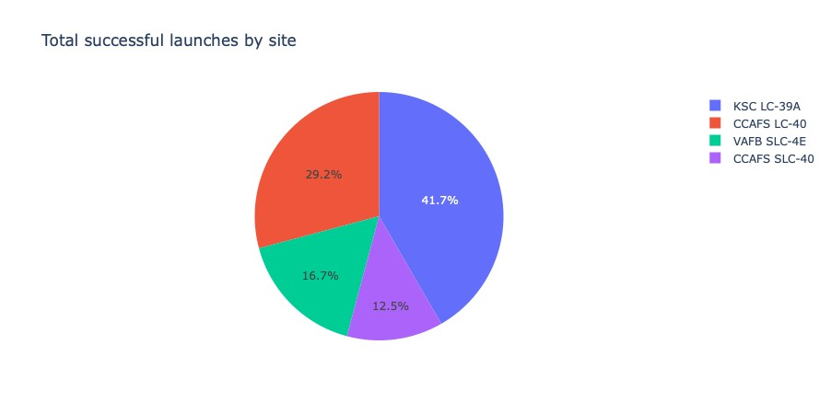
Launch successes across all sites
More successful launches have taken place at KSC.

Slide 39
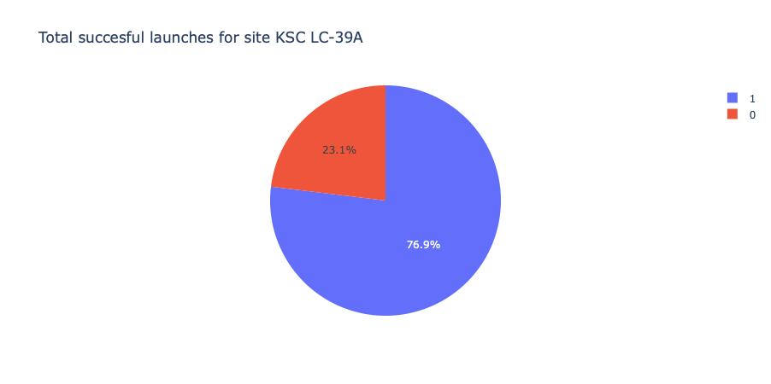
Launch site with the highest success rate
The KSC launch site has the highest success rate so it isn't just the overall number of launches that gives it the highest proportion of successful launches in the previous graph.

Slide 40
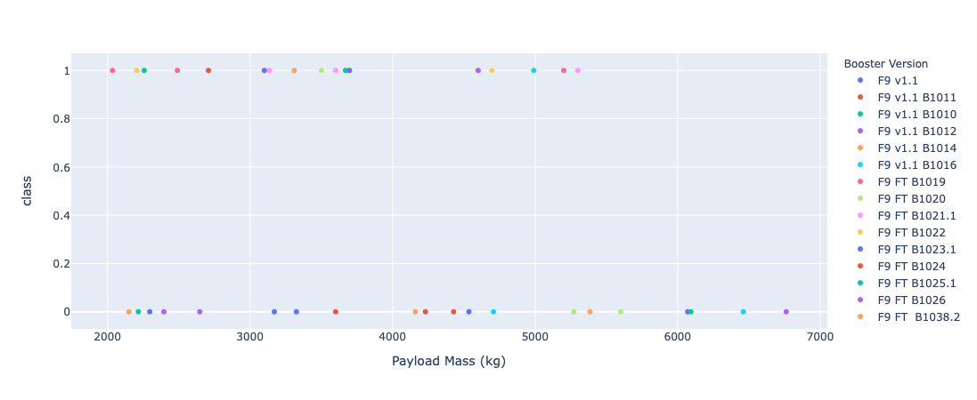
Payload (2000 – 7000 kg) vs. Launch Outcome for all sites
Need to drill down further (e.g. may be recategorize booster types into v1.1 and
FT) to make sense of this data.

Slide 41


Slide 42
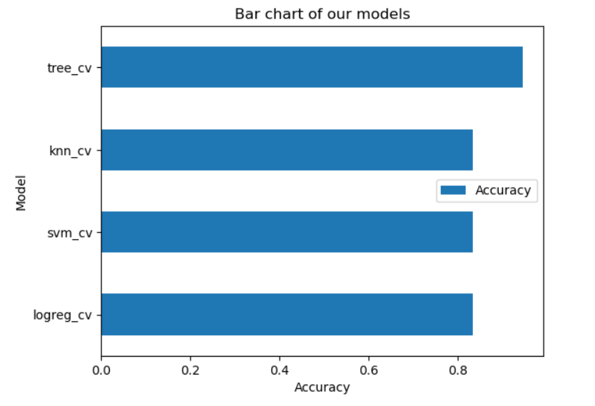
Classification Accuracy
Model accuracy for each
classification models
The decision tree (TREE) classification model showed the highest accuracy at around 0.875.
Tuned hpyerparameters :(best parameters) {'criterion': 'entropy', 'max_depth': 6, 'max_features': 'auto', 'min_samples_leaf': 2, 'min_samples_split': 2, 'splitter': 'random'} accuracy : 0.875

Slide 43
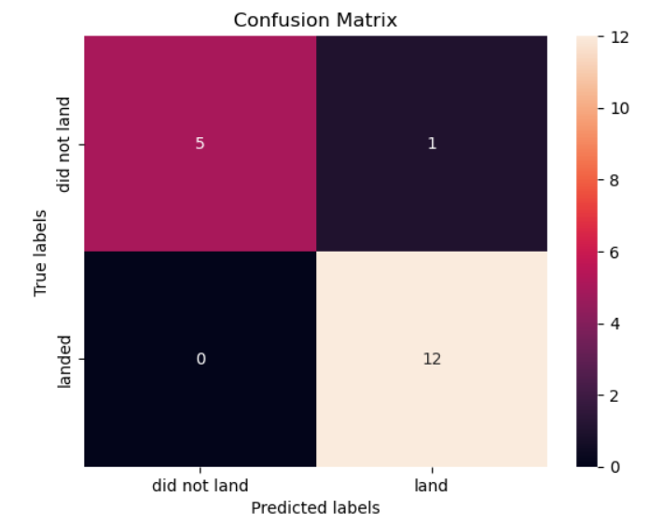
Confusion Matrix
The decision tree showed the fewest combined false positives and false negatives (one of each, so two in total) so, in that respect, was the best model.

Slide 44
Conclusions
Launch success rates increase with time.
The KSC launch site has the best launch
outcomes.
A decision tree is the best classifier for predicting launch outcomes based
on information such as the launch site, payload, orbit and booster types etc.

Slide 45
Appendix
Nothing to add here, other than I'd be massively criticized at work if I produced a presentation like this with over forty slides. A handful of slides is plenty, even to those wanting a "deep dive".
Also, we could have put all our links to our notebooks here, not in the main presentation (the appendix is a really valid place to put them).

Slide 46


